Slide 1
Schedule Snake
Final Presentation
Schedule your classes like never before!
Presented by :
Jay Noppone P, Matthew Munoz,
Baljinder Hothi, William Ng
7/29/24

Slide 2

Table of contents
01
Introduction
02
Relational Data Model
03
Landing Demo
04
Use Cases
What is schedule snake and why choose it?
Preserve data integrity, eliminate redundancy.
A look into a new way of enrollment
How will our customers interact with Schedule Snakes

Slide 3
Table of contents (cont’)
05
Use Case Demo
06
Reporting
07
Member Contributions
08
Financial Plan
A look into a new way of enrolling
How DB was seamlessly implemented
Who did what?
How we will profit off of this

Slide 4
Table of contents (cont’)
09
Q&A
What else would you like to know?

Slide 5
Schedule Snake
Are you tired of juggling conflicting schedules? Schedule Snake is your ultimate solution.
Our innovative system is designed to revolutionize the way you approach scheduling. With Schedule Snake, you can effortlessly organize your weekly schedule, streamlining the entire academic planning process.
Let's transform the academic experience together. Join us in discovering how Schedule Snake can make your life easier.
Schedule Snake

Slide 6
What And Why?
Simplifying the course creation and enrollment process for educators and students alike.
Schedule Snake eliminates the hassle of course registration. No more stressful delays or common enrollment issues.
Schedule Snake: Your university's solution for efficient course management and student enrollment. We offer data-driven insights into course trends.

Slide 7




The Stack
Frontend:
Next.JS
Tailwind CSS
Backend:
Node.JS
Database:
MySQL
Repository & Deployment:
Github
Docker

Slide 8
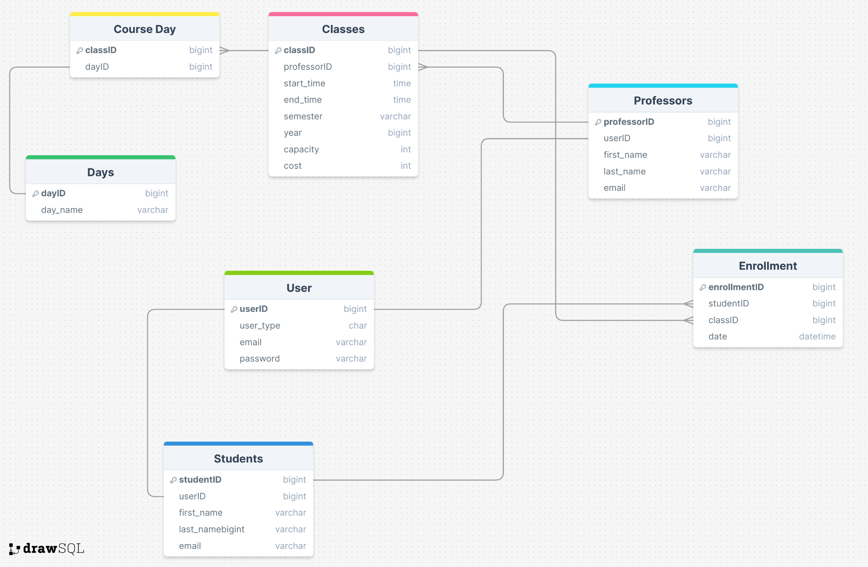
Data Model

Slide 9
Landing
Demo

Slide 10
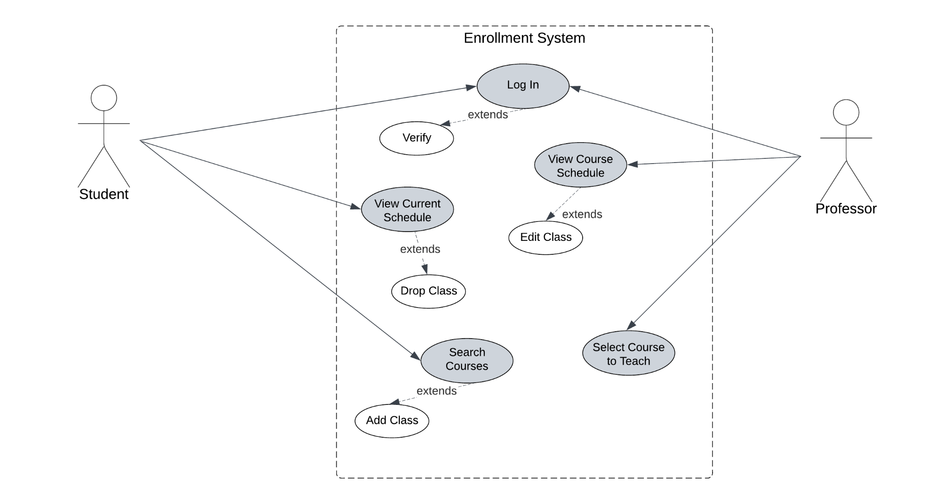
Use Case Diagram

Slide 11
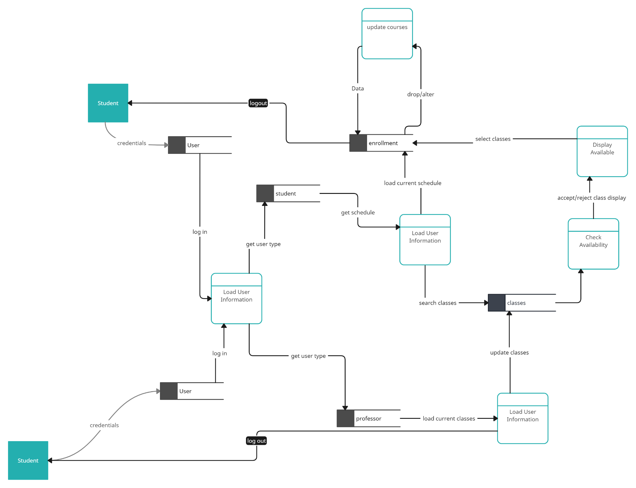
Data Flow Diagram

Slide 12
Student?
User Journey Map
Student sign up using their college credentials
Student views a list of classes at different times with differing professors
If the classes are not available, Student is prompted to select new classes
Student can click enroll on their selected courses
Student can search for specific classes based on class ID or major
If the classes are available the Student enrolls in said classes
The software checks to ensure the classes are available

Slide 13
Professor?
User Journey Map
Professor log in using their college credentials
Professor can make any alterations necessary
Professor views a lost of their currently taught classes
Professor submit changes to allow students to enroll
Professor can add classes if they have the time to teach more classes

Slide 14
User Action
Demo

Slide 15
Reporting

Slide 16
Member Contributions
Jay
Implemented Backend (API’s)
Created DB
Managed overall implementation
Baljinder
UI in figma
Professor page
Implemented Backend
Matthew
Model Diagrams
Cart Page
Enrollment implementation in DB
William
Class search page
Implemented course info in DB
Ensured page consistency

Slide 17
Financial Plan
We plan to make money via a contracted partnership with the Institutions.
We will have different models based on the number of students/ the size of the colleges.
Smaller colleges with less student traffic and courses will not pay the same amount as a larger college such as CCNY where there are thousands of students for dozens of different majors.
We will also incorporate our service directly into the colleges infrastructure.
This means that if the college has their own website for students to view all of their educational information, our service will also appear their for the students to use.
This can be in the terms of redirecting them to our website or it can be a full on inclusion.
The full inclusion of our service into the schools website will also result in a larger charge occurring as that will require much more work and manpower, but will deliver a more user friendly product.

Slide 18
Example Contract
CUNY City College Of New York
5 Year Period(open to extensions)
16,000+ Students in both Graduate and Undergraduate courses
73 Undergraduate Majors and 47 Graduate Programs
Directly Incorporated into CUNY FIRST, no redirecting to our website
Charge:
$15,000 USD Per Year with any additional features being an added charge discussed privately

Slide 19
Extra Credit
Beautiful and seemles user interface
Extra diagrams

Slide 20
Q&A
Thank you for listening to our presentation! - Presented by Jay, Baljinder, Matthew, & William

